Slide 1
PERSONAL PORTFOLIO
WEBSITE
By
Vigneshwari.K
22UCS057
III – BSc (CS)

Slide 2
INTRODUCTION
A portfolio website is a personal digital space designed to showcase my skills, projects, and professional journey. It serves as an interactive resume, allowing visitors to explore my expertise in a visually appealing and organized manner. Built with modern web technologies, it ensures a seamless and responsive experience across all devices. With a focus on clean design, smooth navigation, and optimized performance, this website enhances my online presence and makes it easier for potential employers, clients, and collaborators to connect with me.

Slide 3
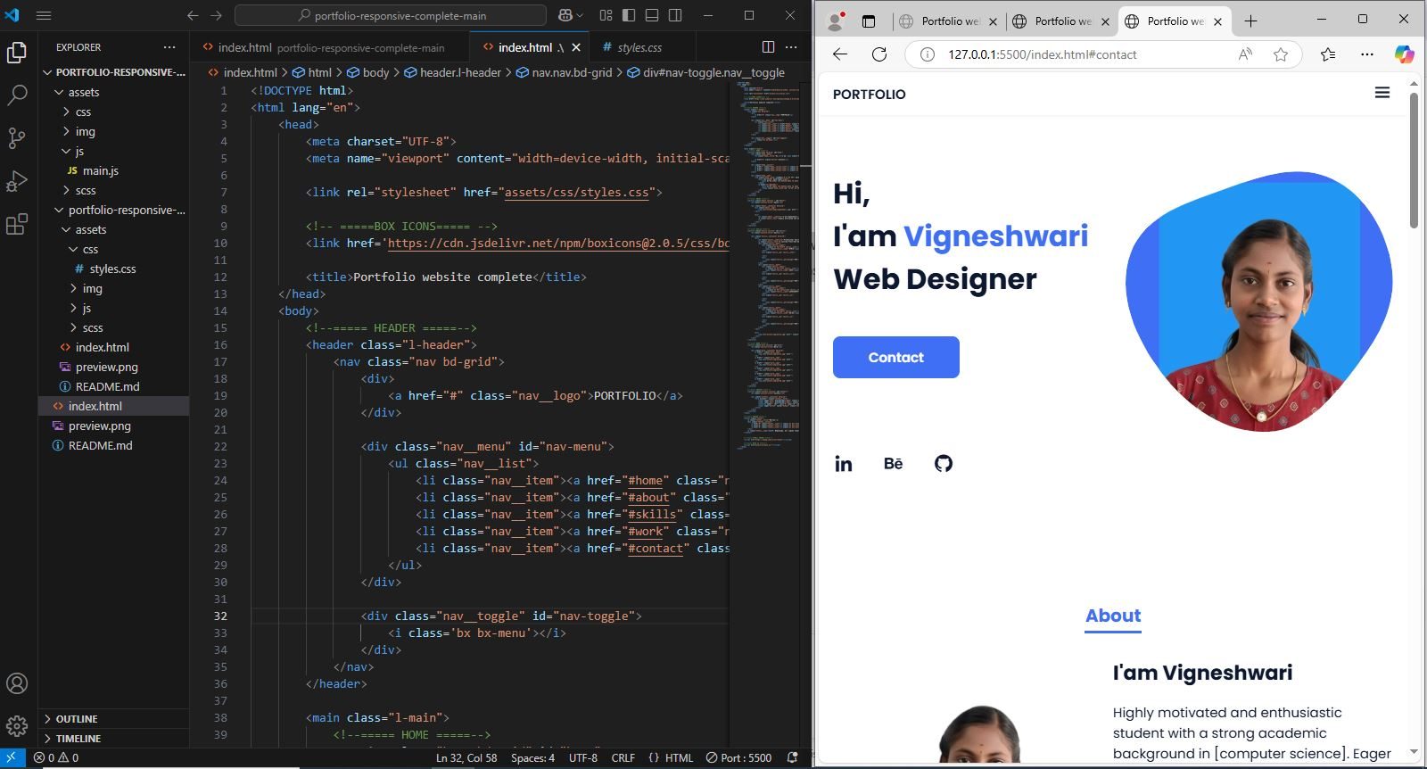
PROGRAM

Slide 4
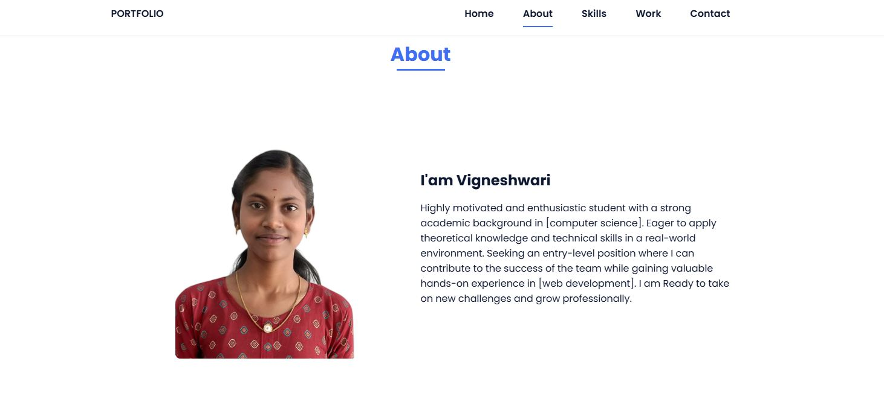
OUTPUT

Slide 5
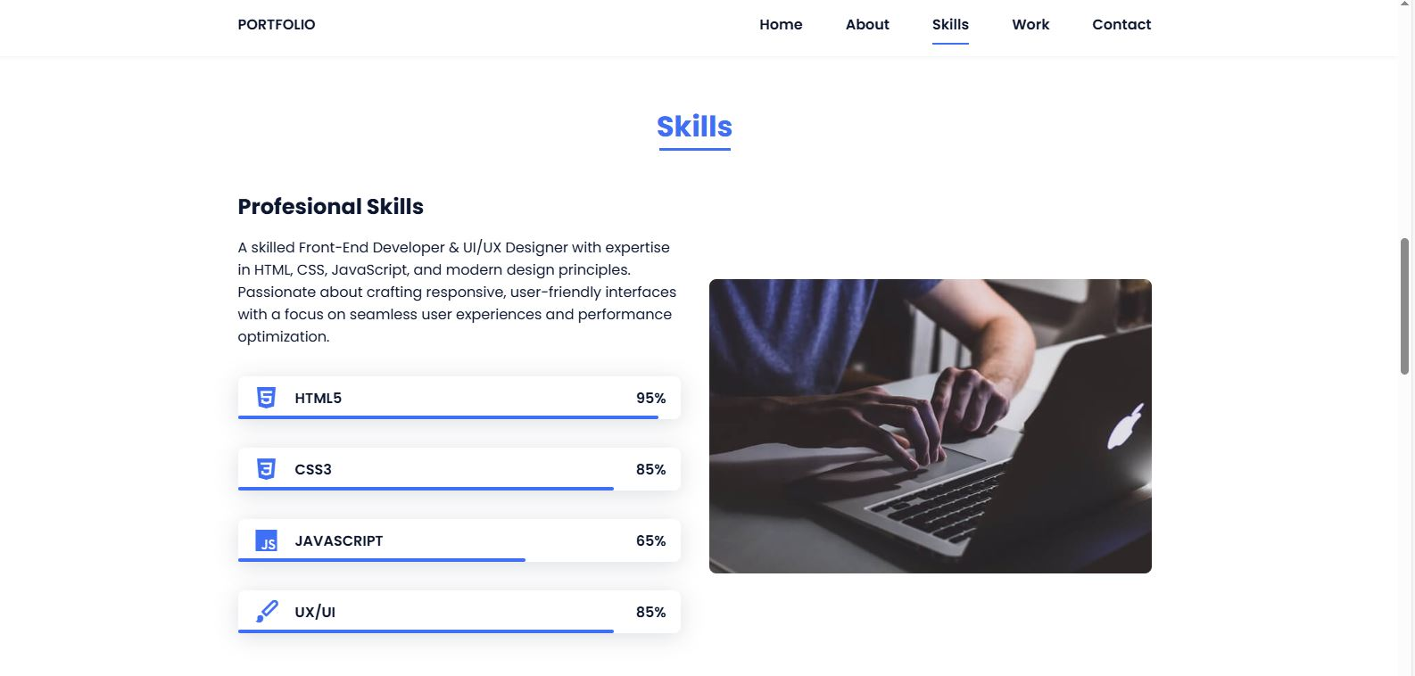
OUTPUT

Slide 6
CONCLUSION
This Portfolio website, built with HTML, CSS, and JavaScript, offers a responsive and visually appealing showcase of my skills and projects. The About section highlights my background, the Skills section presents expertise with interactive elements, and the Work section organizes projects using dynamic filtering. A Contact form with JavaScript validation ensures seamless communication. With CSS Flexbox, Grid, and media queries, the site adapts to all devices, providing a smooth user experience. Future enhancements will focus on performance, dynamic content, and backend integration to further improve functionality.

Slide 7
Thank you

